Slide 1
Energy Transfer and Transformation

Slide 2
Energy Causes Change
Change is when something becomes different.
Energy is the ability to cause change.
Energy Exists in many different forms and causes different types of change.
https://www.youtube.com/watch?v=8qmSzMwTkpk (Bill Nye)
https://www.youtube.com/watch?v=Q0LBegPWzrg (Peek A Boo Kids)

Slide 3
Carousel
This Photo by Unknown Author is licensed under CC BY-SA

Slide 4
Carousel Example
Motion: The ride spins, the ride moves up and down and the riders move up and down
Sound: Sound is a form of energy, the ride plays a song, the riders are laughing and shouting.
Light: The bulbs on the ride light up.
Heat: The bulbs produce heat which is a form of energy.
Electrical Energy: Everything is powered through electrical cords which is a process of electrical energy.

Slide 5
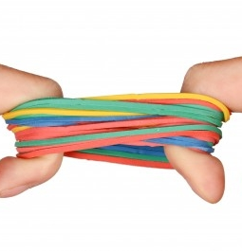
Objects Can Store Energy
Think about a rubber band.
When it is stretched no energy is created, but when it would be let go it would change and create a type of energy. It would make a sound when it was released, and sound is a form of energy.
This is called Stored Energy: which is the energy that has the ability to cause change at a later time.
Any object can have stored energy is a specific position. Think about an apple being held above your head?

Slide 8
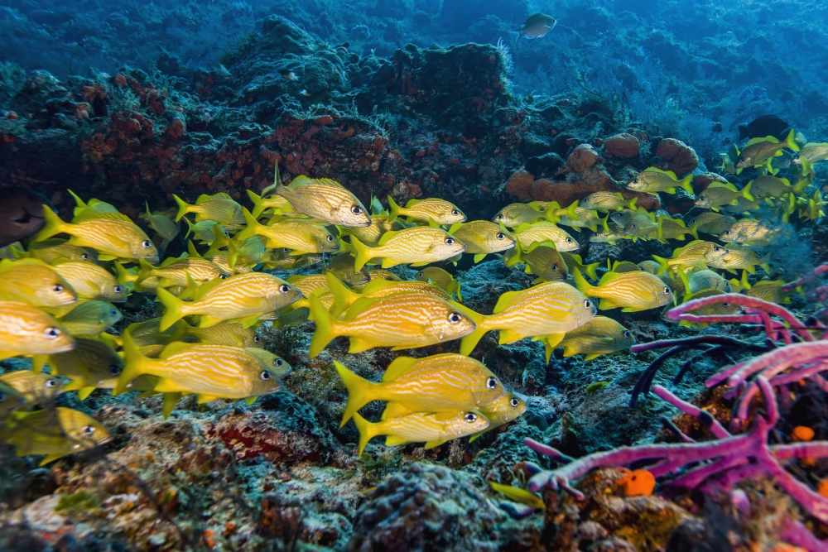
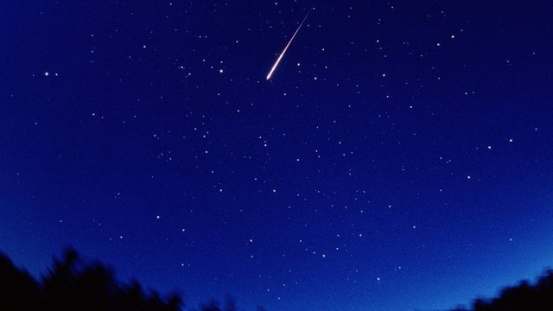
What Is Motion?
The process of an object changing position.
Energy of motion
This Photo by Unknown Author is licensed under CC BY-SA

Slide 9
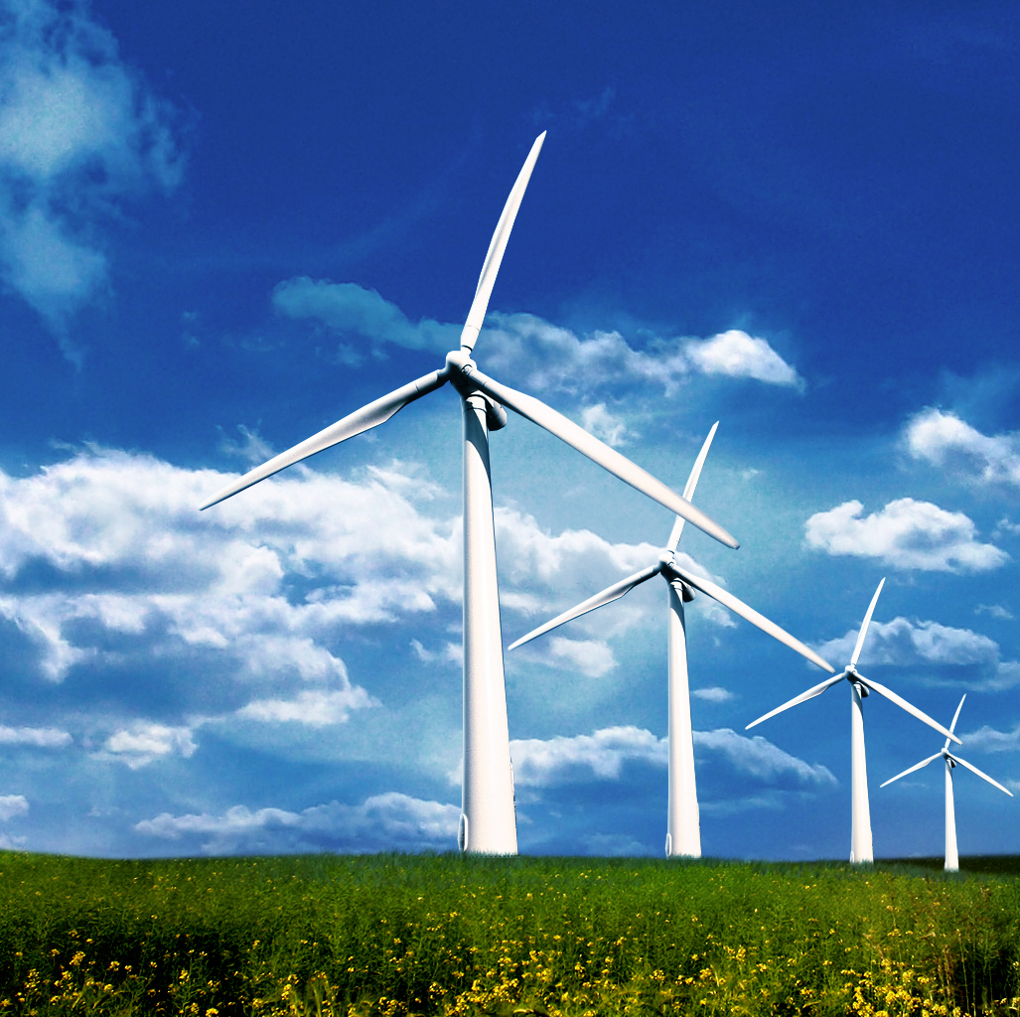
Energy of Motion
Wind Turbines produce energy. What else produces energy that we use?
People give objects energy of motion
Hammering a nail
Passing a Basketball

Slide 12
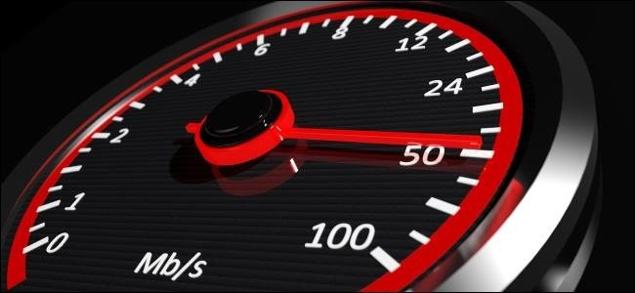
Speed
A measurement of the distance an object travels over an amount of time.

Slide 13
Think about speed in Baseball
The faster something is moving the greater the energy of motion is.

Slide 14
A Ball Rolling
Objects rolling downhill or down a ramp pick up more speed on steeper slopes. Imagine a ball rolling down a ramp. It will have greater energy of motion after rolling down a steep ramp than it will have rolling down a lower ramp of the same length.
The change to the bucket’s position is greater when the ball was moving with more speed. That means the motion energy of the ball was greater when the ball was moving faster.

Slide 15
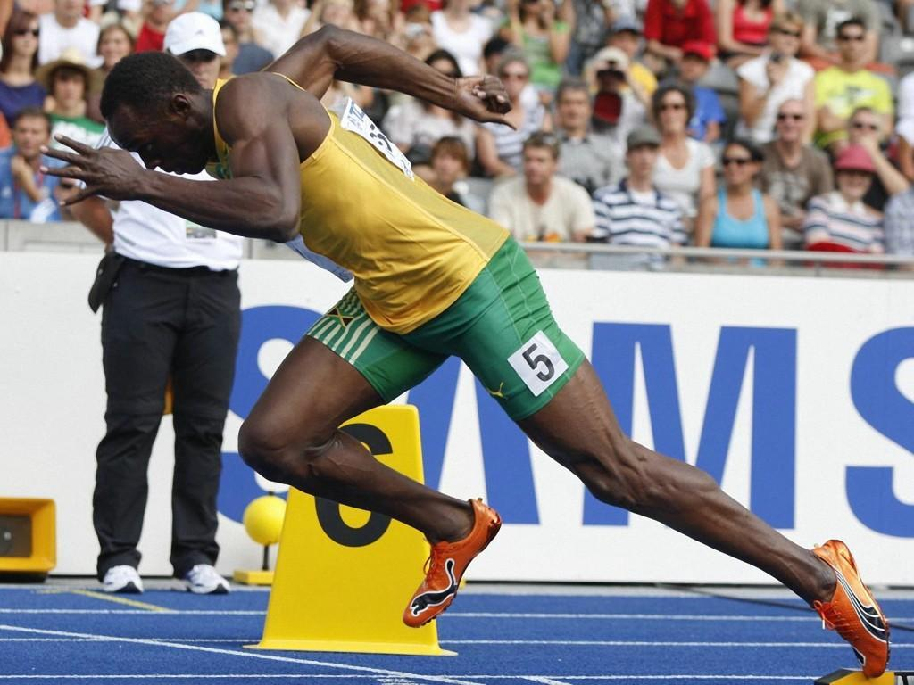
Energy Transfer
Movement of energy from one object to another or from one place to another.

Slide 17
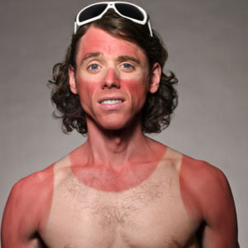
Light Transfers energy
Light transfers energy from a light source, such as a light bulb, to your eyes. The energy of light causes changes in your eyes. These changes allow you to see things around you.
The sun is another light source. Light from the sun transfers across 150 million kilometers of space to reach Earth. That’s 93 million miles that the sun’s light travels to reach us here on Earth! You can see the sunlight reflecting off your skin. Too much of the sunlight can cause an unpleasant change—sunburn!

Slide 18
Sound Transfers Energy
Sometimes when a horn honks nearby or a firework goes off, the sound energy pushes the air, and you feel a push from the sound. Such changes are evidence that an energy transfer happened.

Slide 19
Heat Transfers Energy
Energy also transfers from place to place as heat. If you pour hot tea into a cool cup, soon the cup gets hot. Let a spoon rest in the tea, and soon the spoon gets hot. This is because heat energy transfers from the tea to the cup and to the spoon. The heat energy causes a change. It changes the temperature of the cup and spoon.

Slide 20
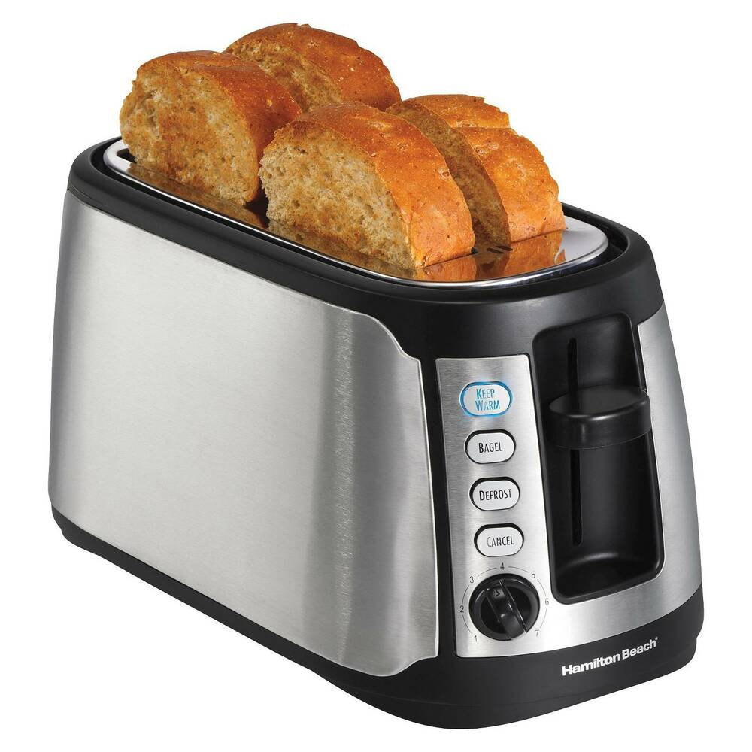
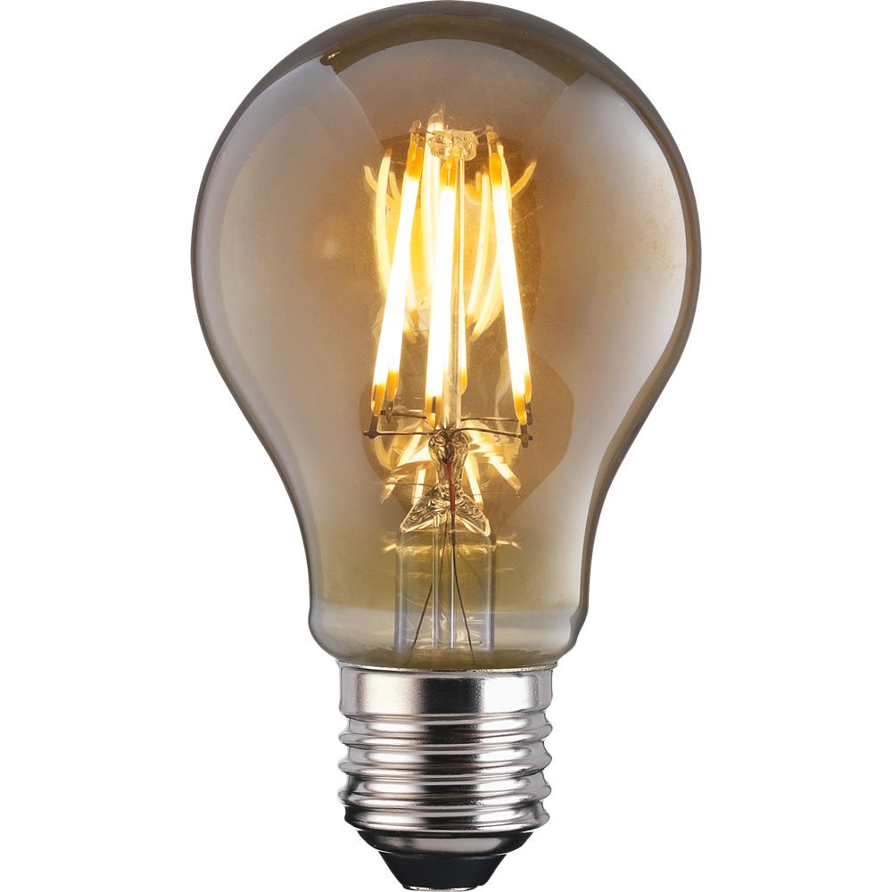
Electricity Transfers Electrical Energy
The glowing light is evidence that energy has moved from one place to another. The transfer of electrical energy causes the change from an unlit bulb to a lit bulb.
Energy is transferred from place to place by electricity. Like all forms of energy, electrical energy moves from place to place and causes changes. You’ve probably seen power lines strung between poles along a road. These wires transfer electrical energy from power plants to homes, schools, and businesses. The electrical energy transferred through these wires causes changes when it is used to heat up your toaster or light your room.

Slide 21
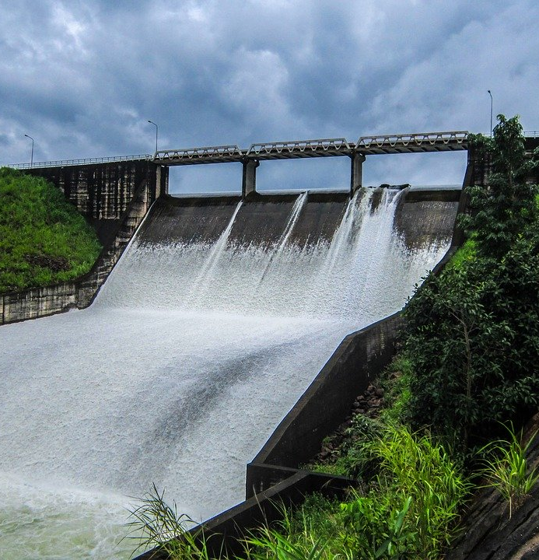
People Transfer Energy to Improve Society
. Scientists and engineers work to find new and better ways to use different forms of energy and transfer them from place to place. Hydroelectric power plants use a series of energy transfers so that the motion energy of water can be converted to electrical energy.
The motion energy of the turbines causes a change that produces electrical energy. And then the energy of electricity moves through wires over long distances, from place to place.

Slide 22
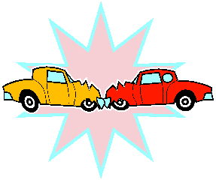
Collisions Transfer Energy
Collide: To come together with impact
Collision: an instance of colliding.

